Slide 1
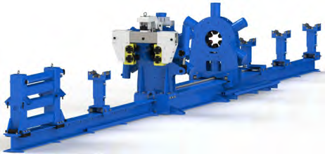
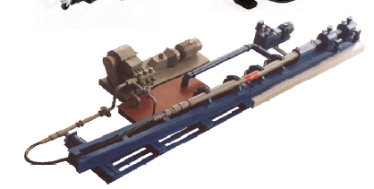
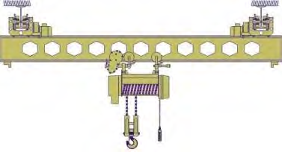
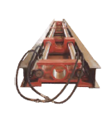
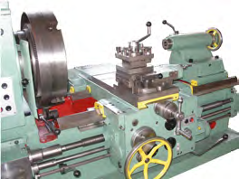
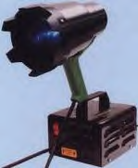
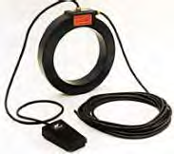
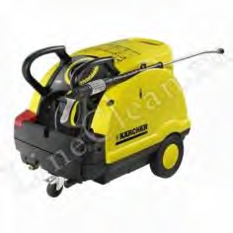
Mud motors service
Mud motors service includes the following works:
1 | Wrench unit for assembling, repairing and disassembling mud motors
2 | Pressing stand for hydraulic testing of the engine and its parts
3 | Cathead for moving mud motors and heavy parts around the service center
4 | Test bench for mud motors to determining the actual performance and assessing the condition of the mud motors
5 | Lathe and pipe cutting machine for repair works
6 | Flaw detection equipment for non-destructive testing of the condition of mud motors parts
7 | Washing machine and auxiliary tools for performing service work

Slide 2
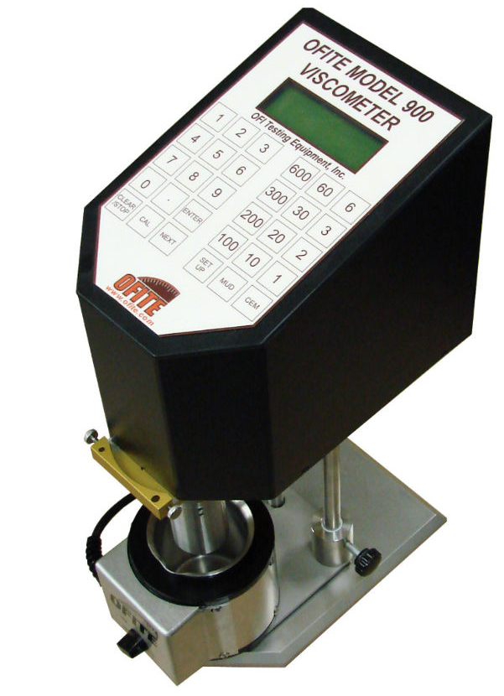
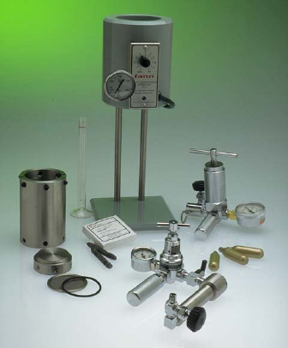
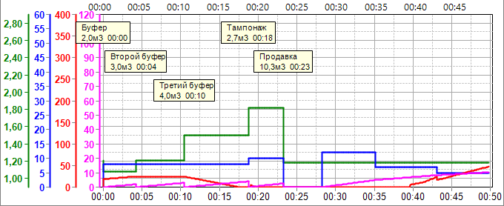
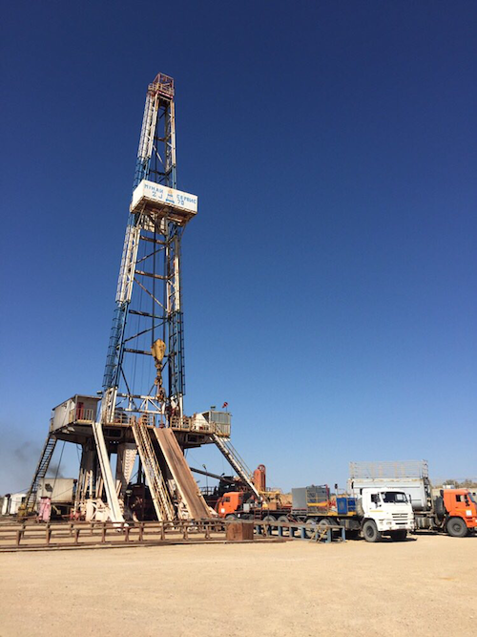
Well cementing and drilling mud service
WC and DM service includes the following works:
1 | Development of recipes for drilling mud and cement slurries, quality control of modifying additives, determination of the main properties of technological fluids for drilling and well completion
2 | Specialized software for performing technological calculations for washing out and cementing of wells
3 | Development of work programs for washing out and cementing of wells
4 | Engineering and technological support of well operations

Slide 3
Casing pipes service
Casing pipes service includes the following works:
Flaw-detecting Coating Marking, packing, storage Determination of the current technical condition of pipes and the possibility of further use

Slide 4
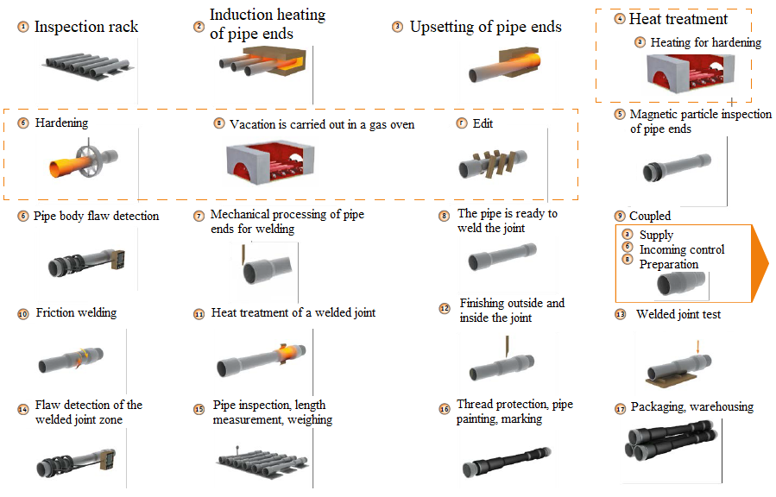
Drill pipes service
Drill pipes service includes the following works:
Flaw-detecting of the welded joint zone Pipe inspection, length measurement, weighing Thread protection, pipe painting, marking Packaging, warehousing

Slide 5
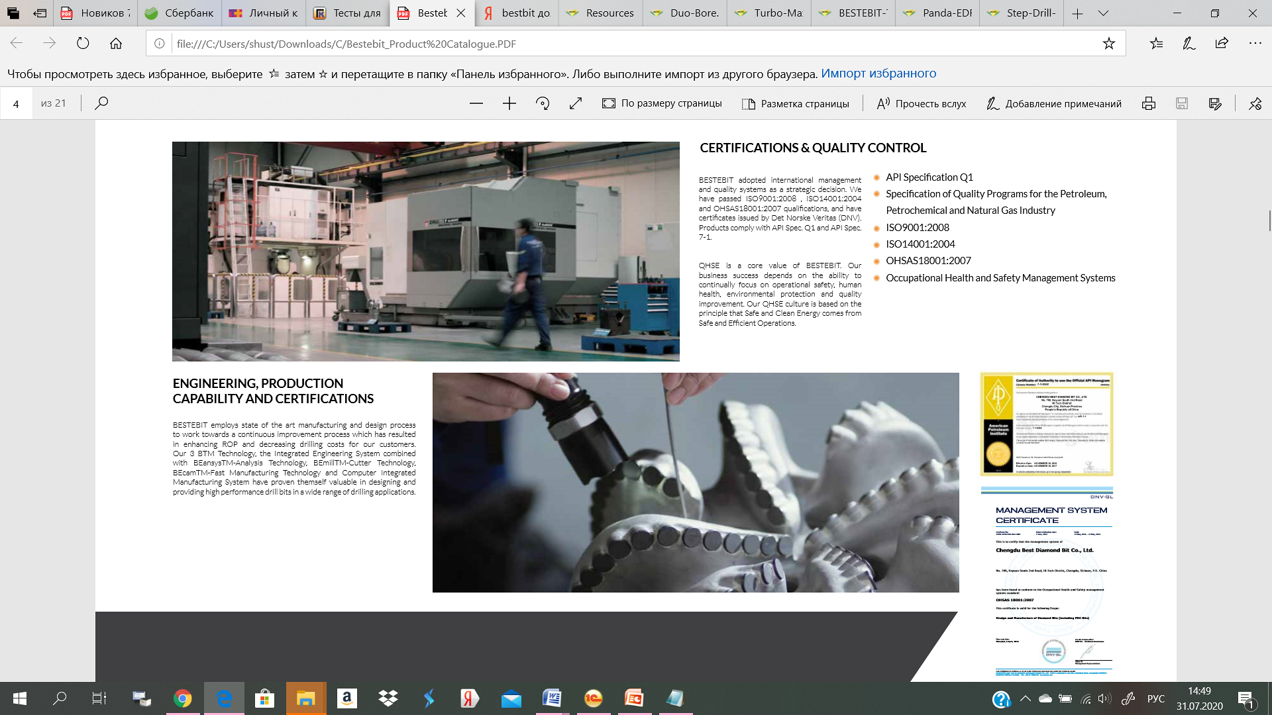
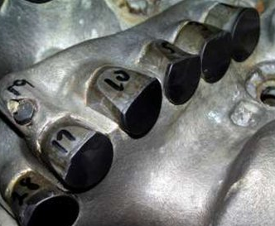
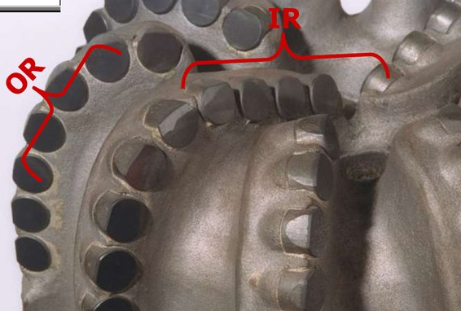
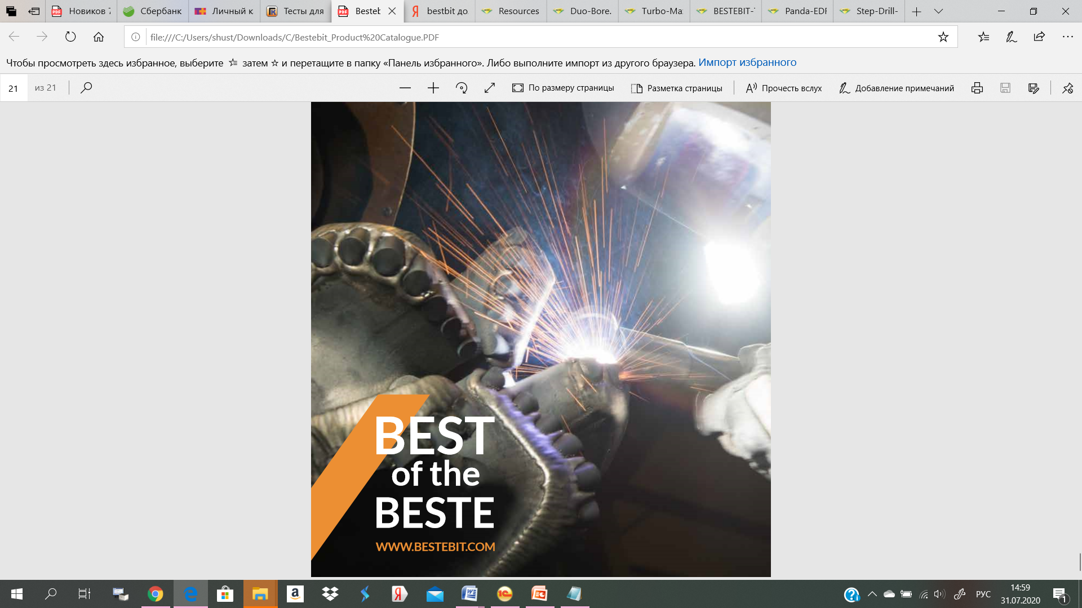
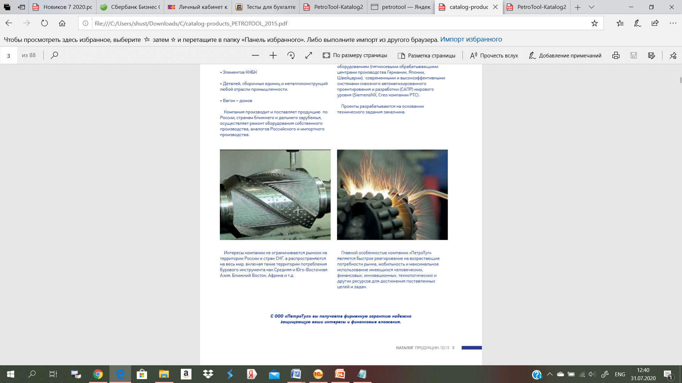
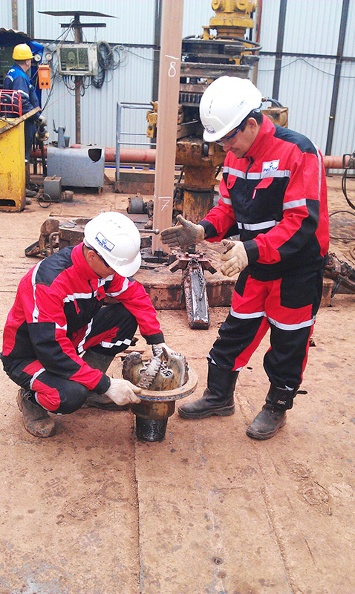
Drill bit service
Drill bit service includes the following works:
1 | Acceptance and assessment of technical condition of drill bits
2 | IADC Dull Grading
3 | Repair of cutting elements and blades of drill bit
4 | Engineering and technological support of well operations

